Slide 1
1. Introduction to Bitcoin and Blockchain
Mastering Bitcoin - Programming the Open Blockchain, 2nd Ed., 2017

Slide 2
What is Bitcoin? (1/3)
Bitcoin is a collection of concepts and technologies that form the basis of a digital money ecosystem. Units of currency called bitcoin are used to store and transmit value among participants in the bitcoin network. Unlike traditional currencies, bitcoin are entirely virtual.
Users of bitcoin own keys that allow them to prove ownership of bitcoin in the bitcoin network. With these keys they can sign transactions to unlock the value and spend it by transferring it to a new owner.
Keys are often stored in a digital wallet on each user’s computer or smartphone. Possession of the key that can sign a transaction is the only prerequisite to spending bitcoin, putting the control entirely in the hands of each user.

Slide 3
What is Bitcoin? (2/3)
Bitcoin is a distributed, peer-to-peer (P2P) system. There is no “central” server or point of control. Bitcoin are created through a process called “mining,” which involves competing to find solutions to a mathematical problem while processing bitcoin transactions.
Every 10 minutes, on average, someone (miner) is able to validate the transactions of the past 10 minutes and is rewarded with brand new bitcoin. Bitcoin mining decentralizes the currency-issuance and clearing functions of a central bank and replaces the need for any central bank.
The bitcoin protocol includes built-in algorithms that regulate the mining function across the network. The difficulty of the processing task that miners must perform is adjusted dynamically so that, on average, someone succeeds every 10 minutes regardless of how many miners (and how much processing) are competing at any moment.

Slide 4
What is Bitcoin? (3/3)
The protocol also halves the rate at which new bitcoin are created every 4 years, and limits the total # of bitcoin that will be created to a fixed total just below 21 million coins by the year 2140. (Deflationary)
Bitcoin represents the culmination of decades of research in cryptography and distributed systems and includes 4 key innovations in a unique and powerful combination:
A decentralized peer-to-peer network (the bitcoin protocol)
A public transaction ledger (the blockchain)
A set of rules for independent transaction validation and currency issuance (consensus rules)
A mechanism for reaching global decentralized consensus on the valid blockchain (Proof-of-Work algorithm)

Slide 5




How to Buy/Trade BTC and Cryptocurrencies
Taiwan based exchange (centralized)
MaiCoin Asset Exchange (MAX)
24Hr Trading Volume: NT$758,371,352 (2022/3/2)
BitoPro
24Hr Trading Volume: NT$330,009,930 (2022/3/2)
International exchange (centralized)
Binance
24Hr Trading Volume: NT$586,693,937,436 (2022/3/2)
Coinbase
24Hr Trading Volume: NT$108,871,940,041 (2022/3/2)

Slide 6

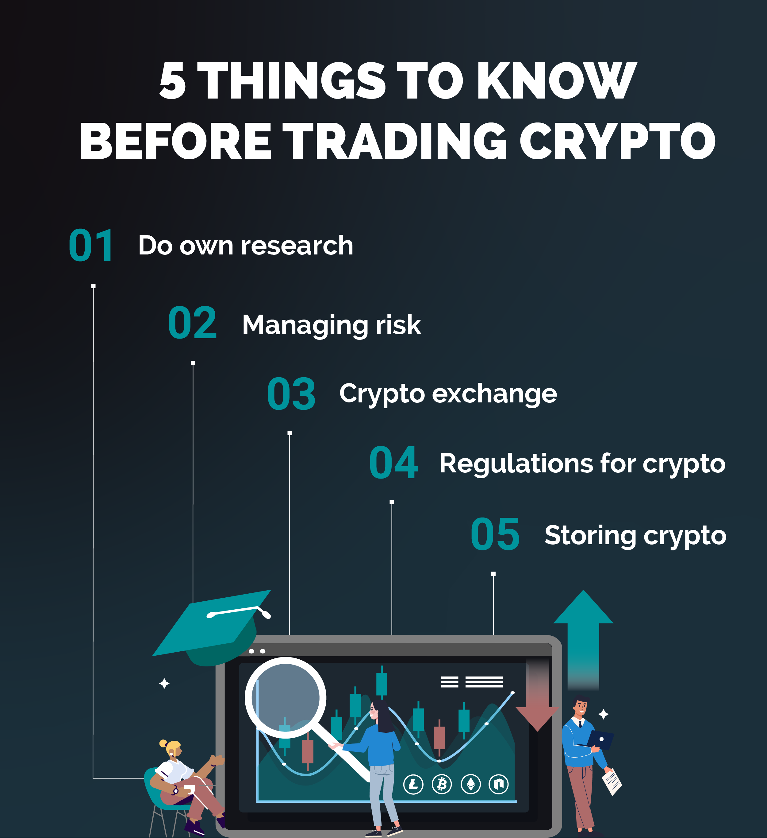

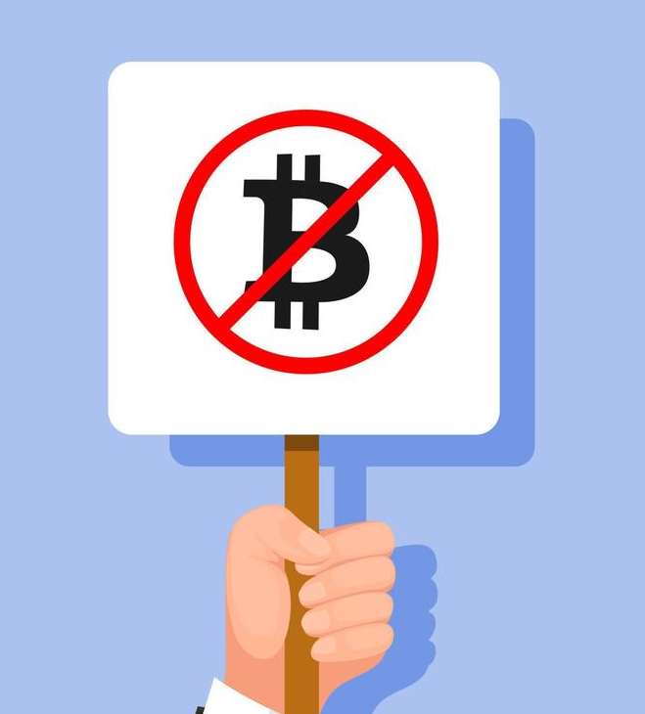

Risk Management in Crypto Trading

Slide 7
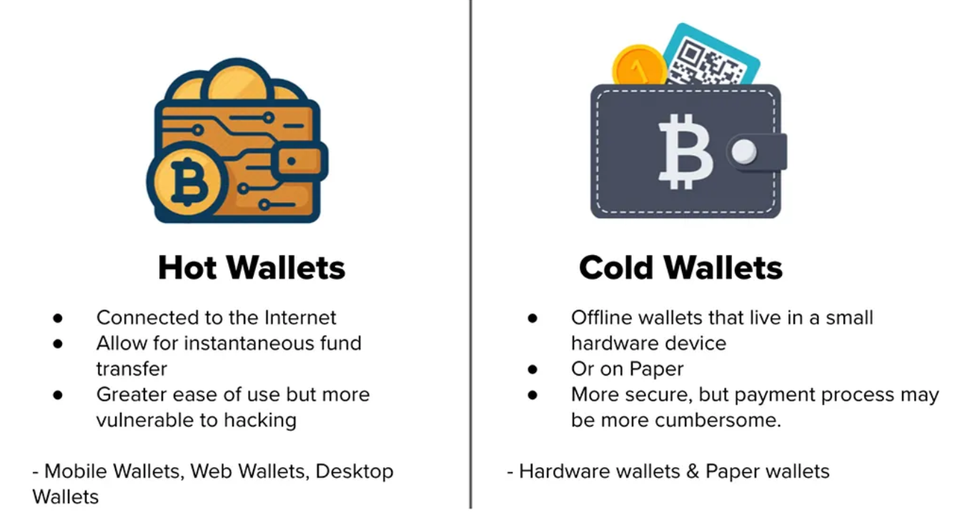
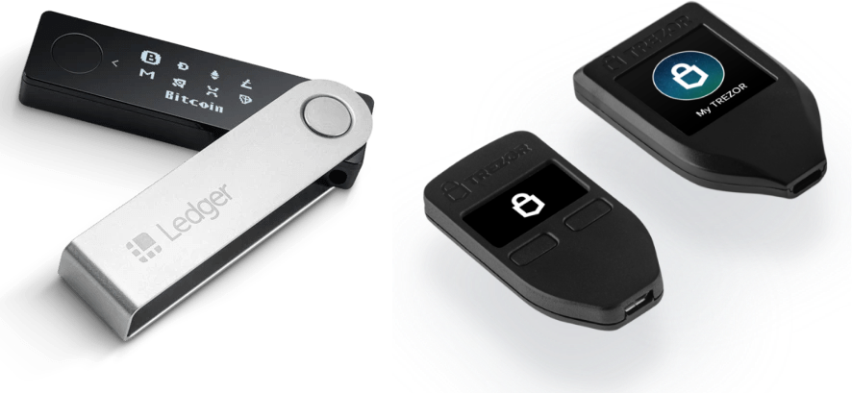
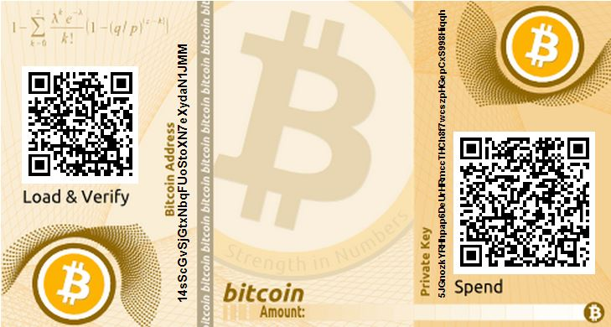
Exercise-1: Using Bitcoin Testnet (1/8)
1. Choose a Bitcoin Wallet

Slide 8
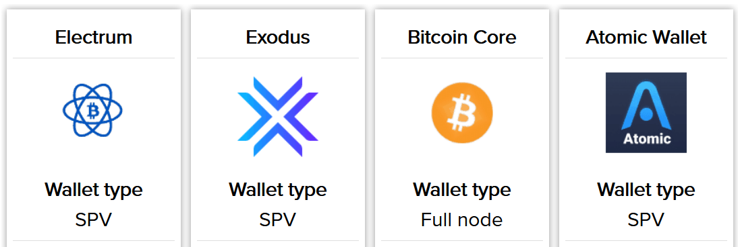
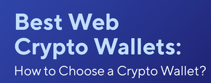
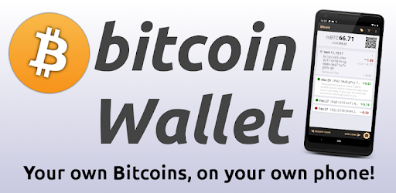
Exercise-1: Using Bitcoin Testnet (2/8)
1. Choose a Bitcoin Wallet (cont.) https://99bitcoins.com/bitcoin-wallet/desktop/
Simplified Payment Verification

Slide 9
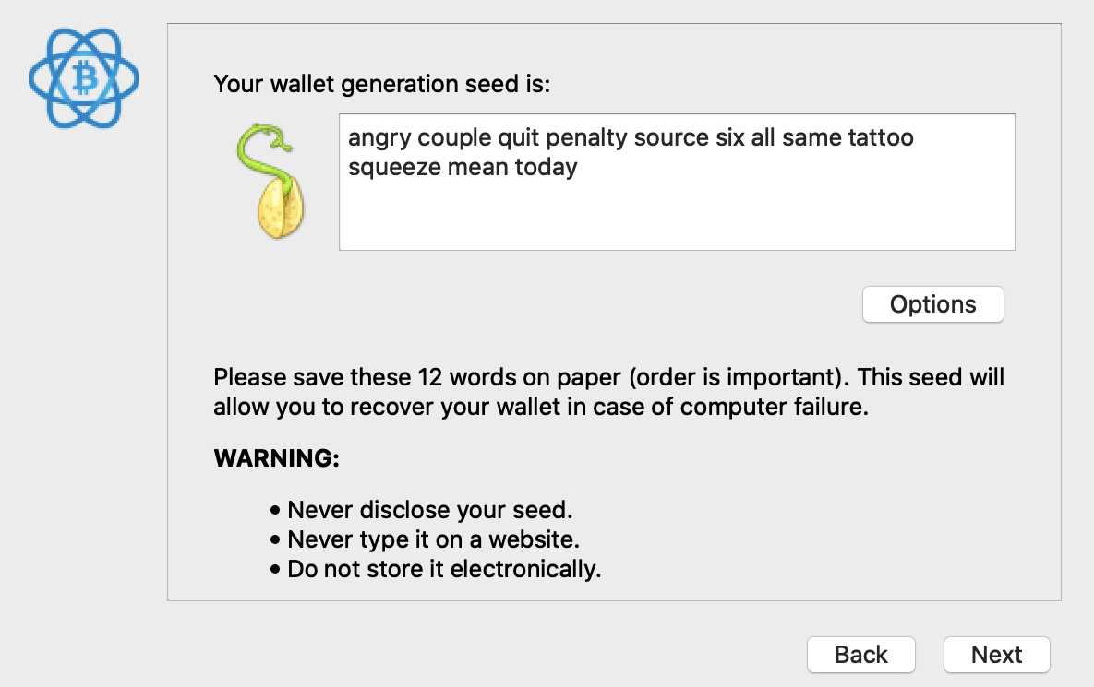
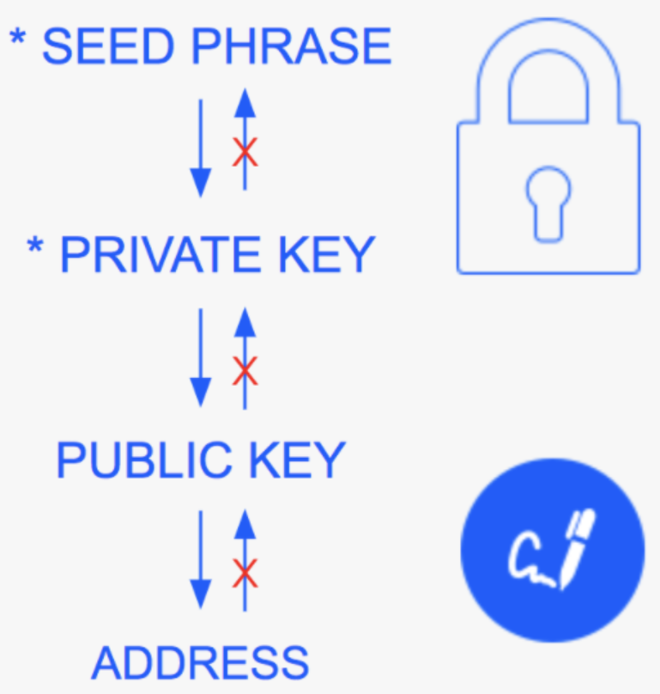
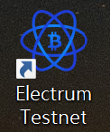
Exercise-1: Using Bitcoin Testnet (3/8)
2. Install Bitcoin Wallet

Slide 10
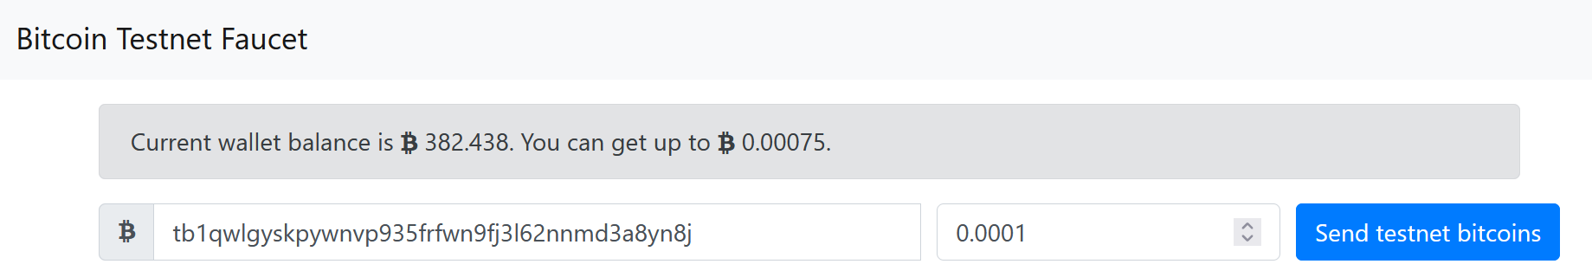
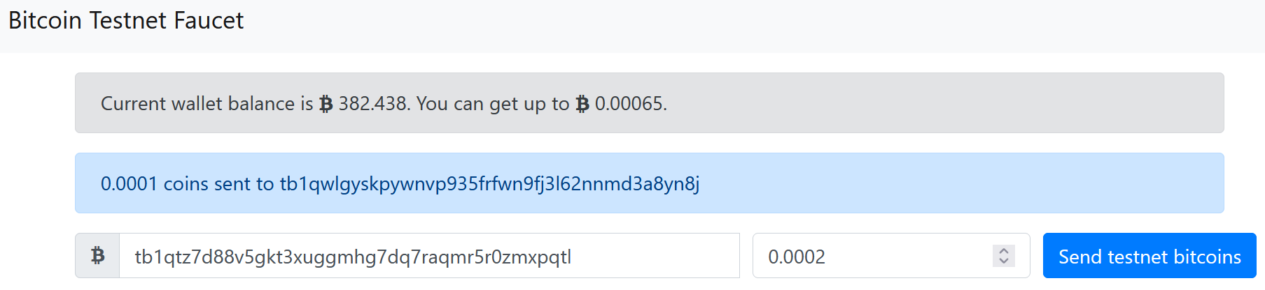
Exercise-1: Using Bitcoin Testnet (4/8)
3. Get free testnet bitcoins from faucet https://bitcoinfaucet.uo1.net/

Slide 11
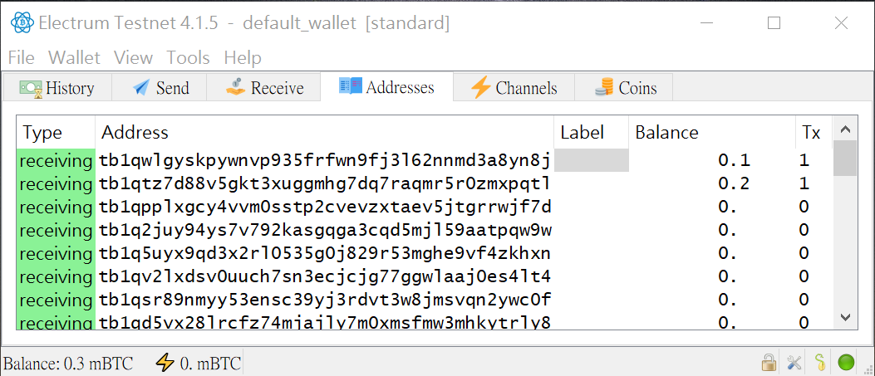
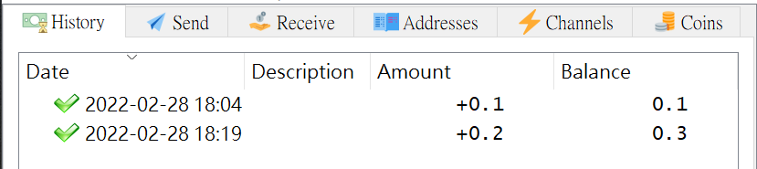
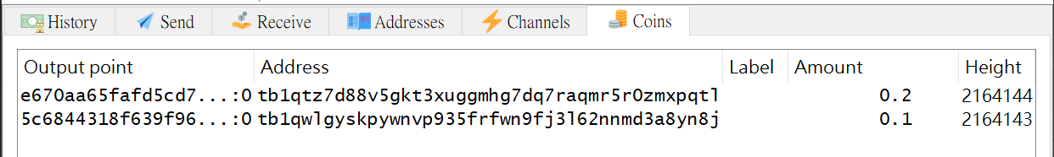
Exercise-1: Using Bitcoin Testnet (5/8)
4. Check your Wallet

Slide 12
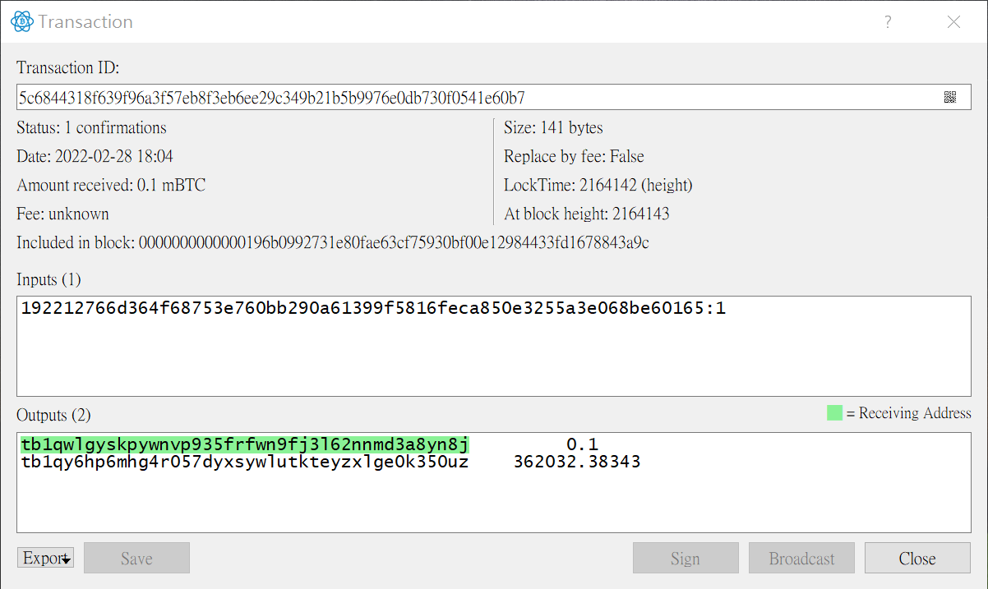
Exercise-1: Using Bitcoin Testnet (6/8)
4. Check your Wallet (cont.)

Slide 13
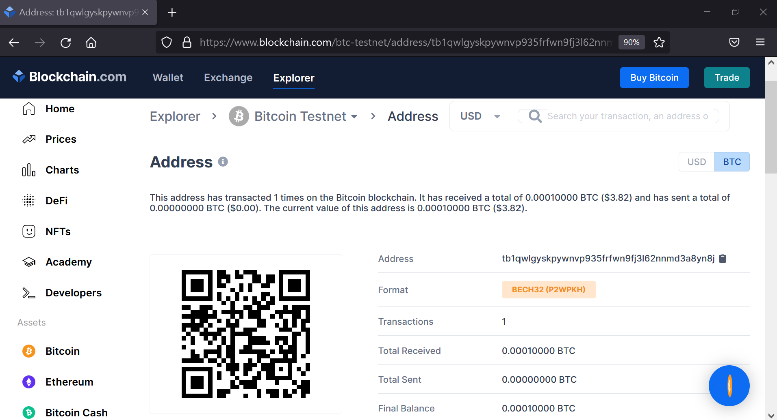
Exercise-1: Using Bitcoin Testnet (7/8)
5. Check the address and the transaction on the explorer
https://www.blockchain.com/explorer Bitcoin Testnet, Bitcoin Explorer...

Slide 14

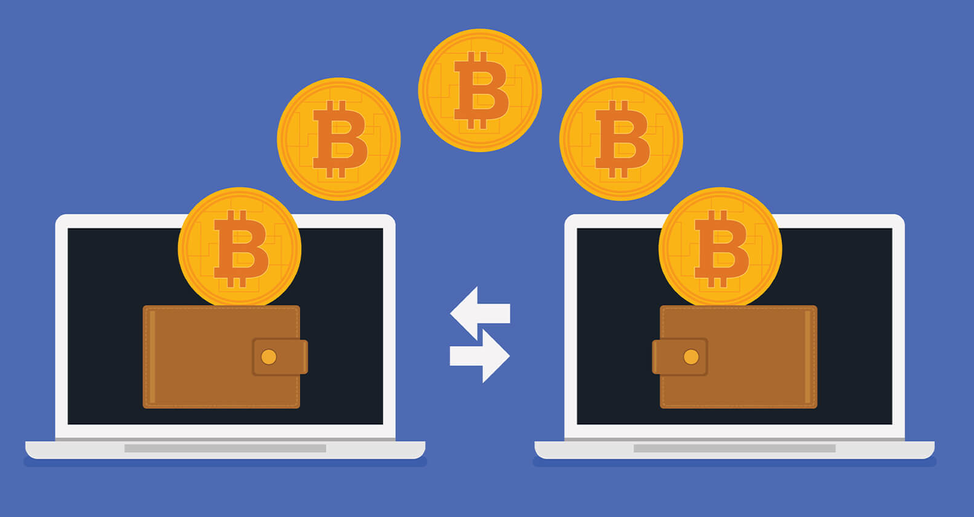
Exercise-1: Using Bitcoin Testnet (8/8)
6. Send some testnet bitcoins to the teacher via the addresses:
tb1qwlgyskpywnvp935frfwn9fj3l62nnmd3a8yn8j
tb1qtz7d88v5gkt3xuggmhg7dq7raqmr5r0zmxpqtl
tb1qpplxgcy4vvm0sstp2cvevzxtaev5jtgrrwjf7d

Slide 15
Basic Questions for Accepting Digital Money
Can I trust that the money is authentic and not counterfeit?
Can I trust that the digital money can only be spent once (known as the “double-spend” problem)?
Can I be sure that no one else can claim this money belongs to them and not me?
Conventional paper money based (stored and transmitted digitally)
The counterfeiting and double-spend issues are handled by clearing all electronic transactions through central authorities that have a global view of the currency in circulation.
Decentralized Digital money
Cryptographic digital signatures for proving the ownership of the asset. With the appropriate architecture, digital signatures also can be used to address the double-spend issue.

Slide 16
Bitcoin Overview (1/3)
The bitcoin system, unlike traditional banking and payment systems, is based on decentralized trust. Instead of a central trusted authority, in bitcoin, trust is achieved as an emergent property from the interactions of different participants in the bitcoin system.
The bitcoin system consists of users with wallets containing keys, transactions that are propagated across the network, and miners who produce (via competitive computation) the consensus blockchain, which is the authoritative ledger of all transactions.

Slide 17
Bitcoin Overview (2/3)

Slide 18
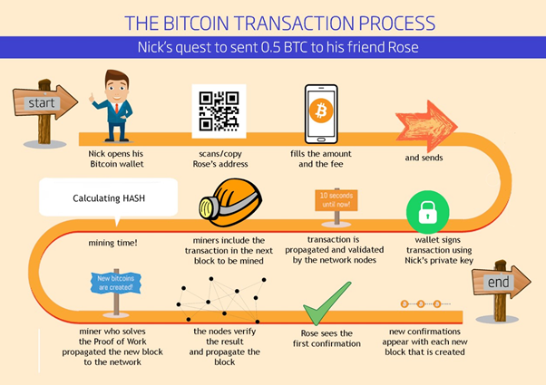
Bitcoin Overview (3/3)

Slide 19
Bitcoin Transactions (1/3)
A transaction tells the network that the owner of some bitcoin value has authorized the transfer of that value to another owner. The new owner can spend the bitcoin by creating another transaction that authorizes transfer to another owner, etc., in a chain of ownership.
Transactions are like lines in a double-entry bookkeeping ledger. Each transaction contains one or more “inputs,” which are like debits against a bitcoin account. On the other side of the transaction, there are one or more “outputs,” which are like credits added to a bitcoin account.
Outputs add up to slightly less than inputs and the difference represents an implied transaction fee, which is a small payment collected by the miner who includes the transaction in the ledger.

Slide 20
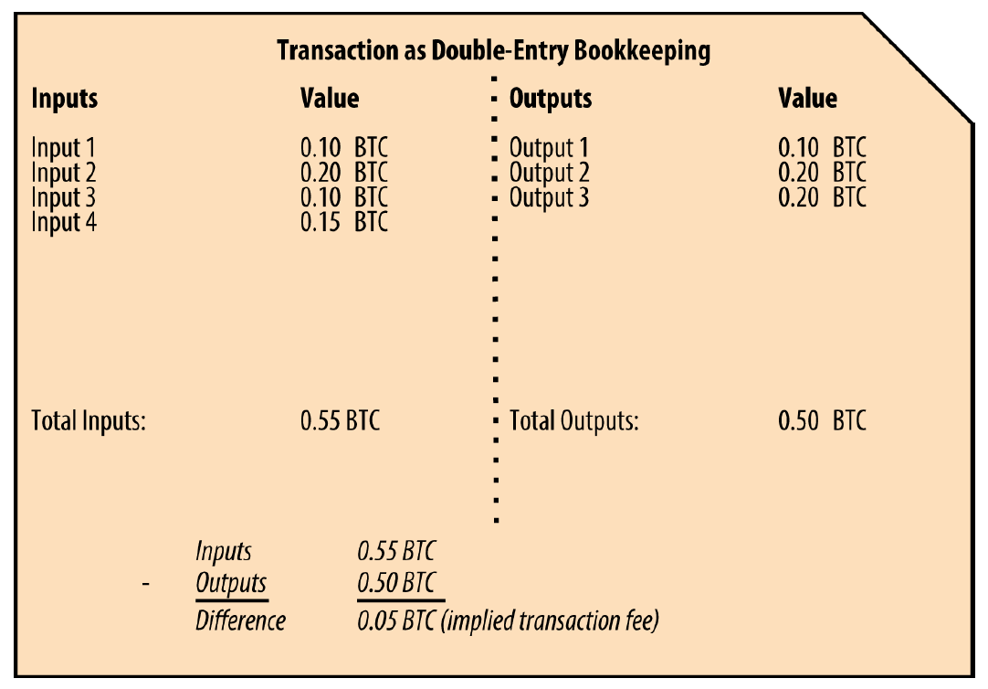
Bitcoin Transactions (2/3)

Slide 21
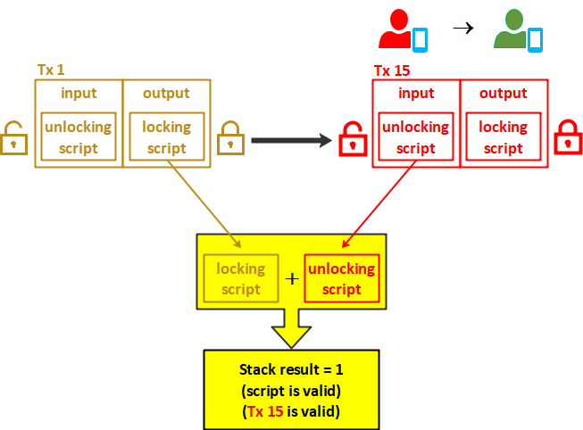
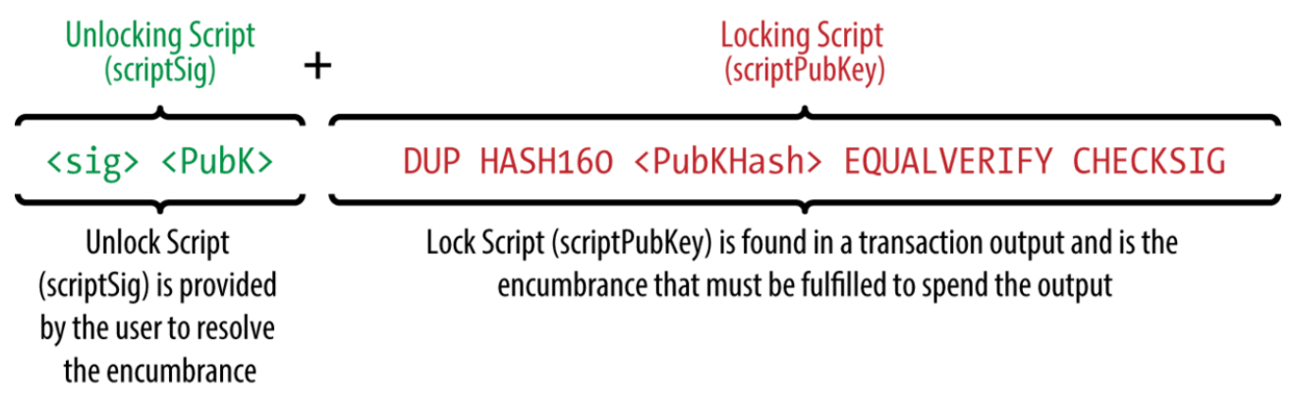
Bitcoin Transactions (3/3)
The transaction also contains proof of ownership for each amount of bitcoin (inputs) whose value is being spent, in the form of a digital signature from the owner, which can be independently validated by anyone. In bitcoin terms, “spending” is signing a transaction that transfers value from a previous transaction over to a new owner identified by a bitcoin address.
(These details will be covered in the lecture of “Bitcoin Transaction”)

Slide 22
Make Change (1/2)
Many bitcoin transactions will include outputs that reference both an address of the new owner and an address of the current owner, called the change address.
If you purchased an item that costs 5 bitcoin but only had a 20 bitcoin input to use, you would send one output of 5 bitcoin to the store owner and one output of 15 bitcoin back to yourself as change (less any applicable transaction fee).
Importantly, the change address does not have to be the same address as that of the input and for privacy reasons is often a new address from the owner’s wallet.

Slide 23
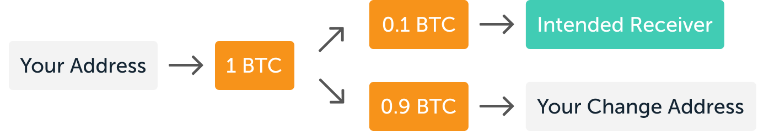
Make Change (2/2)
Different wallets may use different strategies when aggregating inputs to make a payment requested by the user.
They might aggregate many small inputs, or use one that is equal to or larger than the desired payment. Unless the wallet can aggregate inputs in such a way to exactly match the desired payment plus transaction fees, the wallet will need to generate some change.

Slide 24
Transactions Chains (1/2)
Transactions move value from transaction inputs to transaction outputs. An input is a reference to a previous transaction’s output, showing where the value is coming from.
A transaction output directs a specific value to a new owner’s bitcoin address and can include a change output back to the original owner. Outputs from one transaction can be used as inputs in a new transaction, thus creating a chain of ownership as the value is moved from owner to owner.

Slide 25
Transactions Chains (2/2)

Slide 26
Transaction Forms

Slide 27
Constructing a Transaction (1/4)
Wallet application contains all the logic for selecting appropriate inputs and outputs to build a transaction.
1. Getting the Right Inputs
Wallet has to find inputs to can pay for the amount the owner wants to send. Most wallets keep track of all the available outputs belonging to addresses in the wallet.
Wallet application that runs as a full-node client contains a copy of every unspent output from every transaction in the blockchain. This allows a wallet to construct transaction inputs as well as quickly verify incoming transactions as having correct inputs.
However, because a full-node client takes up a lot of disk space, most user wallets run “lightweight” clients (Simplified Payment Verification Nodes) that track only the user’s own unspent outputs.

Slide 28
Constructing a Transaction (2/4)
If the wallet application does not maintain a copy of unspent transaction outputs, it can query the bitcoin network to retrieve this information using a variety of APIs available by different providers or by asking a full-node using an application programming interface (API) call.
2. Creating the Outputs
A transaction output is created in the form of a script that creates an encumbrance on the value and can only be redeemed by the introduction of a solution to the script.
Meaning of the script: “This output is payable to whoever can present a signature from the key corresponding to the receiver’s public address.”
For the transaction to be processed by the network in a timely fashion, wallet application will add a small fee. This is not explicit in the transaction; it is implied by the difference between inputs and outputs.

Slide 29
Constructing a Transaction (3/4)
(change)

Slide 30
Constructing a Transaction (4/4)
3. Adding the Transaction to the Ledger
The transaction must be transmitted to the bitcoin network where it will become part of the blockchain.
The bitcoin network is a P2P network, with each bitcoin client participating by connecting to several other bitcoin clients. Purpose of the bitcoin network is to propagate transactions and blocks to all participants.
Any system (server, desktop application, wallet) that participates in the bitcoin network by “speaking” the bitcoin protocol is called a bitcoin node.
Any bitcoin node that receives a valid transaction it has not seen before will immediately forward it to all other nodes to which it is connected, a propagation technique known as flooding. The transaction rapidly propagates out across the P2P network, reaching a large percentage of the nodes within a few seconds.

Slide 31
Bitcoin Mining (1/2)
A transaction does not become part of the blockchain until it is verified and included in a block by a process called mining.
The bitcoin system of trust is based on computation. Transactions are bundled into blocks, which require an enormous amount of computation to prove, but only a small amount of computation to verify as proven.
Mining process serves two purposes in bitcoin:
Mining nodes validate all transactions by reference to bitcoin’s consensus rules. Therefore, mining provides security for bitcoin transactions by rejecting invalid or malformed transactions.
Mining creates new bitcoin in each block, almost like a central bank printing new money. The amount of bitcoin created per block is limited and diminishes with time, following a fixed issuance schedule.

Slide 32
Bitcoin Mining (2/2)
Mining uses electricity to solve a mathematical problem. A successful miner will collect a reward in the form of new bitcoin and transaction fees. However, the reward will only be collected if the miner has correctly validated all the transactions, to the satisfaction of the rules of consensus.
Finding such a solution, the so-called Proof-of-Work (PoW), requires quadrillions of hashing operations per second across the entire bitcoin network. PoW algorithm involves repeatedly hashing the header of the block and a random number with the SHA256 cryptographic algorithm until a solution matching a predetermined pattern emerges. The first miner to find such a solution wins the round of competition and publishes that block into the blockchain.

Slide 33
Mining Transactions in Blocks (1/3)
New transactions are constantly flowing into the network from user wallets and other applications. As these are seen by the bitcoin network nodes, they get added to a temporary pool of unverified transactions maintained by each node (miner).
As miners construct a new block, they add unverified transactions from this pool to the new block and then attempt to prove the validity of that new block, with the mining algorithm (Proof-of-Work).
Transactions are added to the new block, prioritized by the highest-fee transactions first and a few other criteria.
Each miner starts the process of mining a new block of transactions as soon as he receives the previous block from the network, knowing he has lost that previous round of competition.

Slide 34
Mining Transactions in Blocks (2/3)
The miner immediately creates a new block, fills it with transactions and the fingerprint of the previous block, and starts calculating the Proof-of-Work for the new block. Each miner includes a special transaction in his block, one that pays his own bitcoin address the block reward (currently 6.25 newly created bitcoin, 2022) plus the sum of transaction fees from all the transactions included in the block.
If the miner finds a solution that makes that block valid, he “wins” this reward because his successful block is added to the global blockchain and the reward transaction he included becomes spendable.
The block containing a transaction (e.g. Alice’s transaction on the next page) is counted as one “confirmation” of that transaction.

Slide 35
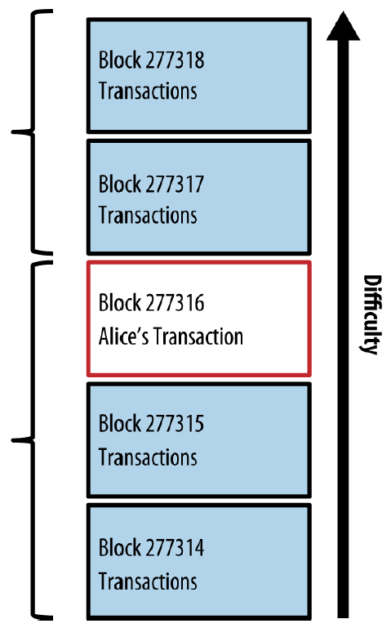
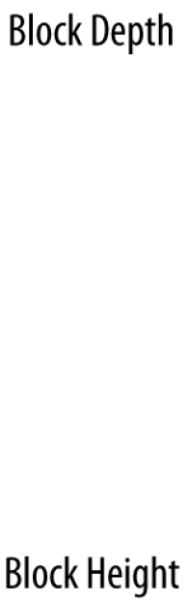
Mining Transactions in Blocks (3/3)
E.g. Below block #277316 are 277,316 blocks (including block #0), linked to each other in a chain of blocks (blockchain) all the way back to block #0, known as the genesis block.
Over time, as the “height” in blocks increases, so does the computation difficulty for each block and the chain as a whole.
The blocks mined after the one that contains Alice’s transaction act as further assurance, as they pile on more computation in a longer and longer chain. By convention, any block with more than six confirmations is considered irrevocable, because it would require an immense amount of computation to invalidate and recalculate six blocks.
Latest Block
(2)
# new blocks after the block of interest
(Alice -> Bob)
(277316)
Starting from block #0

Slide 36
Spending the Transaction (1/2)
Now that Alice’s transaction has been embedded in the blockchain as part of a block, it is part of the distributed ledger of bitcoin and visible to all bitcoin applications. Each bitcoin client can independently verify the transaction as valid and spendable. Bob can now spend the output from this and other transactions (as shown on the next slide).
Full-node clients can track the source of the funds from the moment the bitcoin were first generated in a block, incrementally from transaction to transaction, until they reach Bob’s address.
Lightweight clients can do what is called a simplified payment verification by confirming that the transaction is in the blockchain and has several blocks mined after it, thus providing assurance that the miners accepted it as valid.

Slide 37
Spending the Transaction (2/2)

Slide 38
Dealing with Double Spending (1/3)
Imagine that you have 1 BTC and you attempt to spend it twice in two separate transactions.
You could attempt to do this by sending the same BTC to two separate bitcoin wallet addresses. Both of these transactions will then go into the pool of unconfirmed transactions.
The first transaction would be approved via the confirmation mechanism and then verified into the subsequent block.
However, the second transaction would be recognized as invalid by the confirmation process and would not be verified.
If both transactions are pulled from the pool for confirmation simultaneously, the transaction with the highest number of confirmations will be included in the blockchain, while the other one will be discarded.

Slide 39
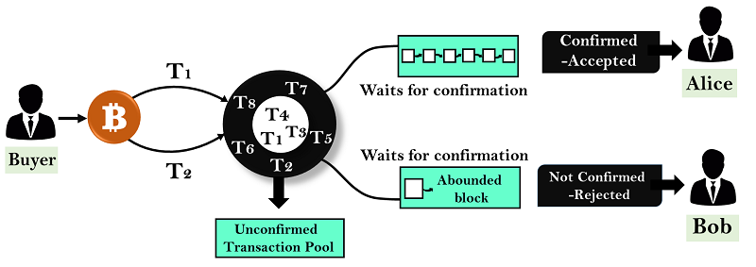
Dealing with Double Spending (2/3)
Issue #1: The intended recipient of the second (failed) transaction would not have a part in the transaction itself failing, and yet that person would not receive the bitcoin they had anticipated.
Many merchants wait for at least 6 confirmations of a transaction (meaning that six subsequent blocks of transactions were added to the blockchain after the transaction in question). At this point, the merchant can safely assume that the transaction is valid.

Slide 40
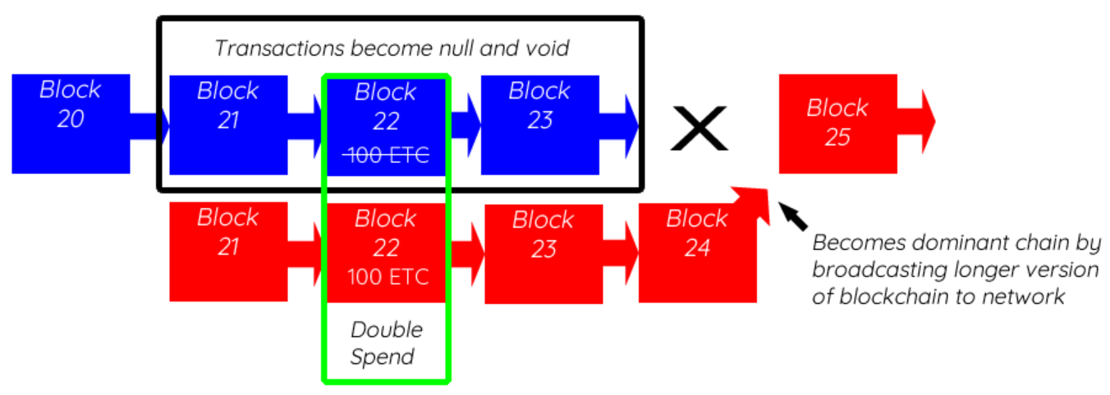

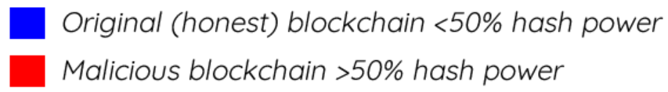
Dealing with Double Spending (3/3)
Issue #2: if an attacker is somehow able to control at least 51% of the hash power of the network, they can commit double spending.
If an attacker were somehow able to get control of this much computational power, they could reverse transactions and create a separate, private blockchain. However, the rapid growth of bitcoin has virtually insured that this type of attack is impossible.

